Slide 1
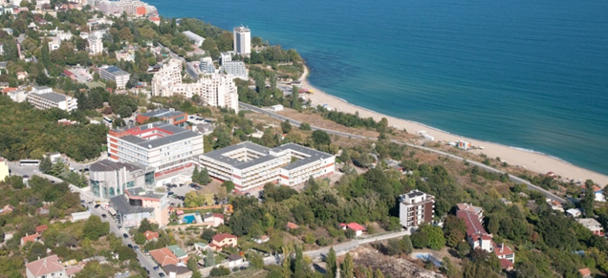
Knowledge and skills for sustainable development:
the impact of the new Master programme “Circular Economy” at Varna Free University

Slide 2
EU sustainable environmental framework
The 7th Environment Action Programme
to protect, conserve and enhance the Union’s natural capital
to turn the Union into a resource-efficient, green, and competitive low-carbon economy
to safeguard the Union's citizens from environment-related pressures and risks to health and wellbeing

Slide 3
TRANSITION TOWARDS A CIRCULAR ECONOMY

Slide 4
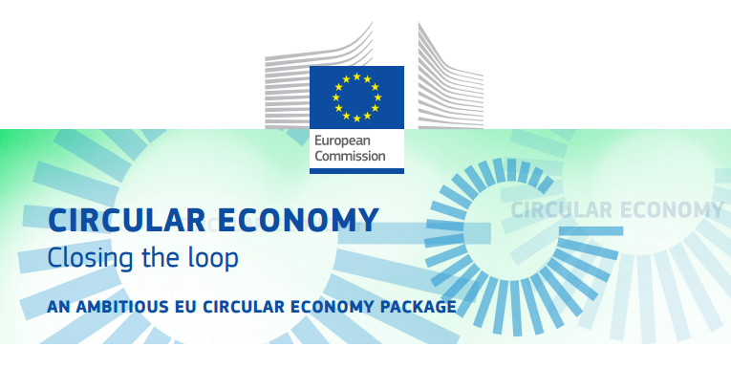
EU 2018 Circular Economy Package
Circular economy
EU Strategy for Plastics in the Circular Economy
Interface between chemicals, products and waste Legislation
Monitoring Framework on progress towards a circular economy
Report on Critical Raw Materials and the circular economy.
Port Reception Facilities including the impact of the use of oxo-degradable plastic.
Development the National strategies for the Circular economy

Slide 5
In response to the challenges
Creating a new educational product
Master program CIRCULAR ECONOMY
Synergy of the academic capacity through partnership
Joining resources, infrastructure and capacity;
Dissemination and implementation of good practices;
Business partners.
Black Sea Region
Danube Region
Western Balkans
Format 16+1
European Education Area

Slide 6
Prerequisites
Correspondence between the priorities and VFU’s academic profile – launched university projects 2018
Creativity
Entrepreneurship
Leadership in the global environment
Educational network 16+1
On the silk road
Digitalization and cyber security
WEBIT
Circular economy

Slide 7
Major fields of education in Circular economy
Global and EU problems and policies
Sustainable development
Environment policy
Interface chemical products waste legislation
Life cycle of the products
Inter-company cooperation
National and regional regulations
Partnership and coordination in the regional projects
Taxation
Circular economy
Waste management
Financial models

Slide 8
Minor fields of education in Circular economy
Ecological entrepreneurship
Sustainable business systems
Resource management
EU institutional system
EU structural and investments funds
EU law
Social interactions
Change management
Design management
Technological infrastructure
Circular and green economy
Business intelligent analyzes
Sustainable architectural solutions
Investment decisions
Technological entrepreneurship and innovation

Slide 9
Learning advantages
The training of the students in the Master's program "Circular Economy" is conducted in accordance with the European Credit Transfer and Accumulation System (ECTS);
The mobility of students and teachers;
The implementation of practices and internships (including in the EU institutions);
Participation in master classes, conferences, round tables, etc.
Innovative, practice-oriented training to build new skills and competences;
Open learning, case studies;
New, modern, innovative and creative teaching methods;
Work on practical-applied projects and research-related tasks in a real environment.
Personalized accent according to the trainee's professional area;
Acquisition of competences related to the specifics of regional development.

Slide 10
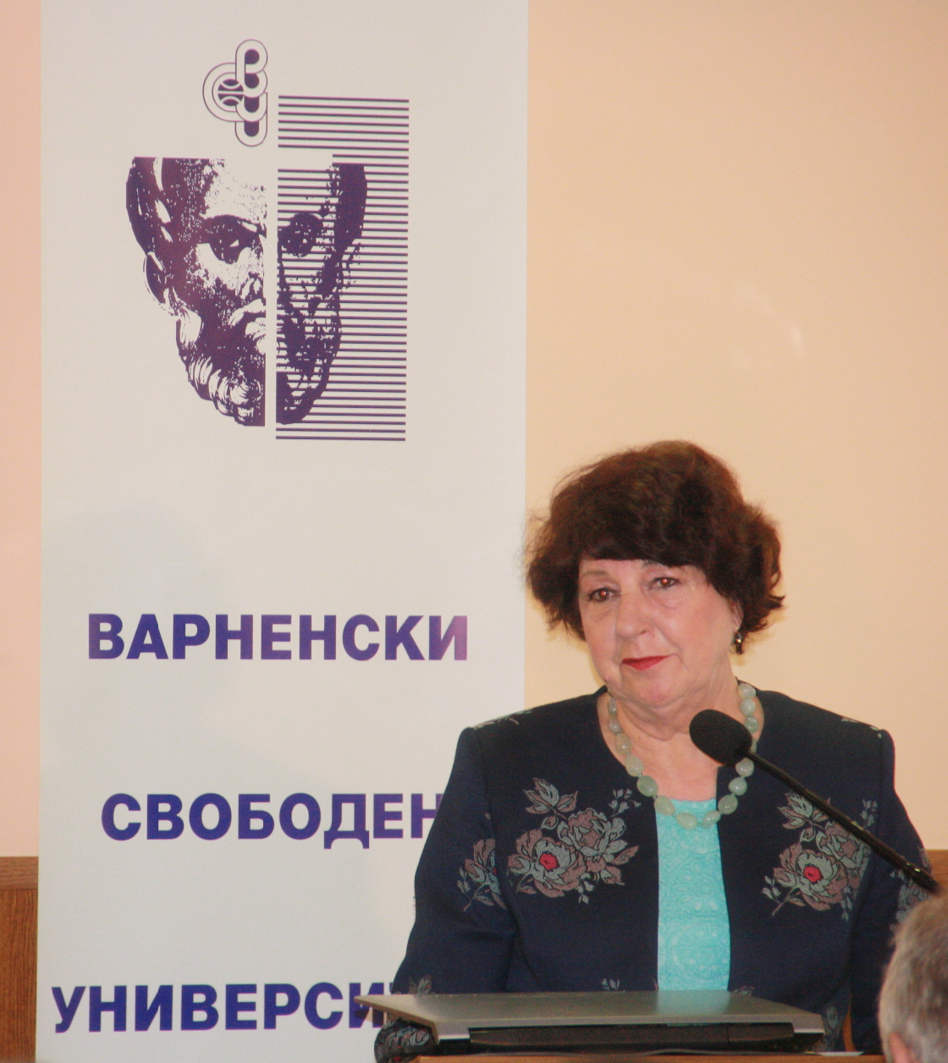
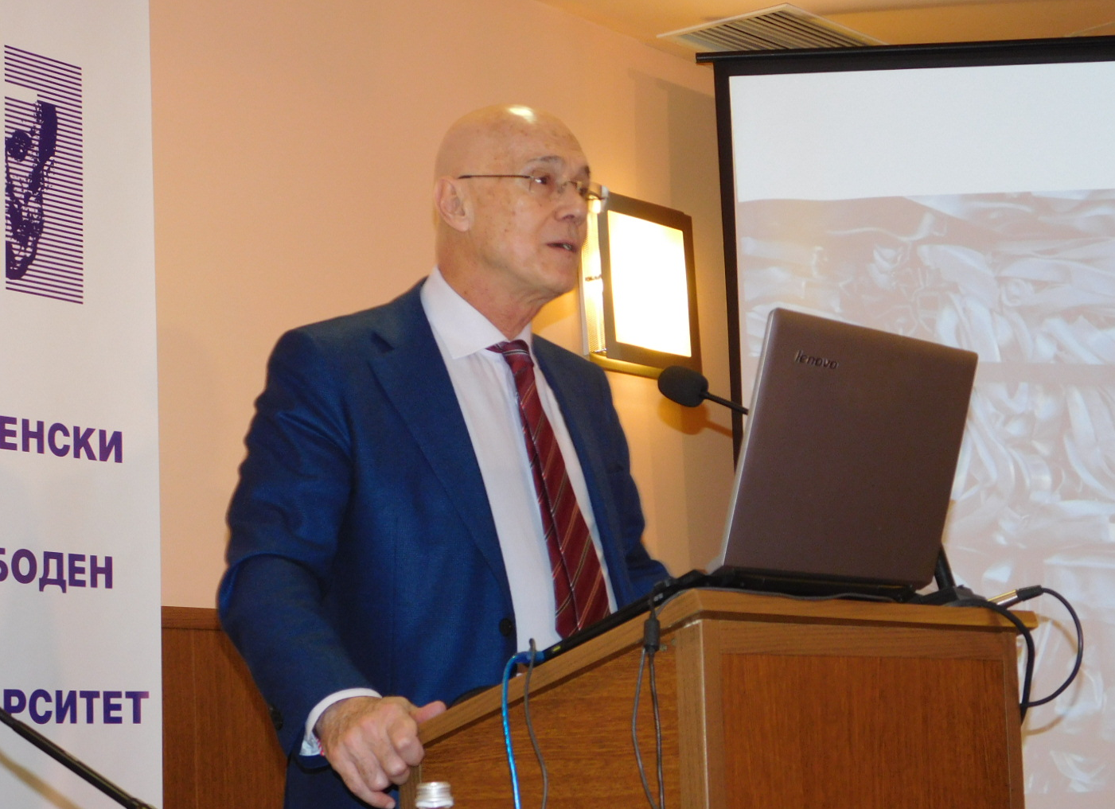
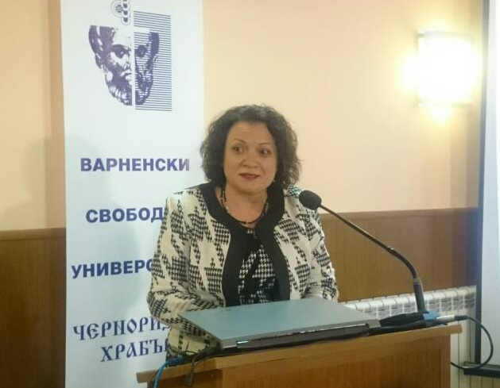
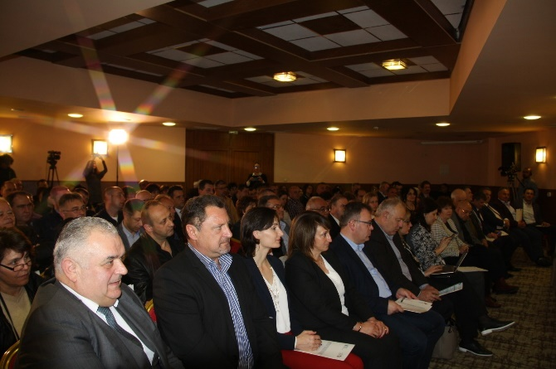
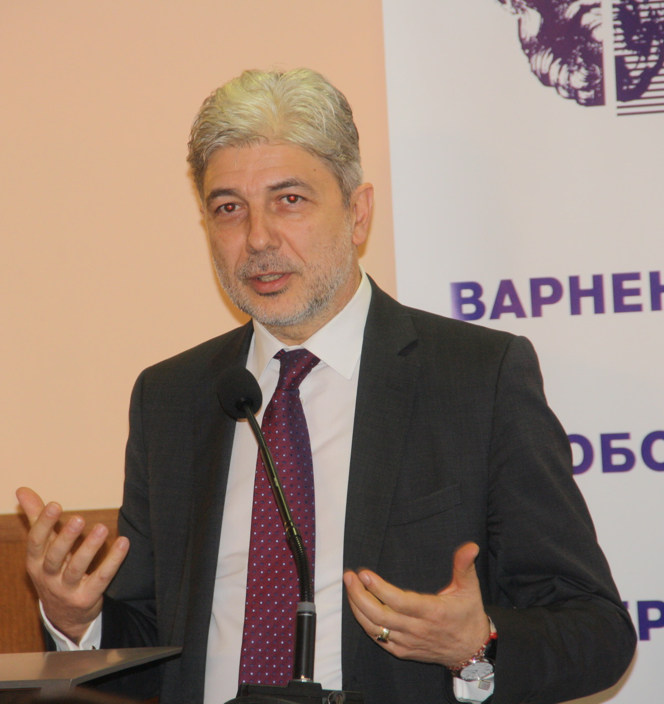
VFU partners
EC Directorate-General for
the Environment,
Bulgarian Parliamentary Commission on
Environment and Water,
Ministry of Environment and Water
Representatives of Bulgarian and foreign public,
non-governmental and business organization.

Slide 11
First steps
The series of trainings conducted within the Institute for Integrated Municipal Governance at VFU in the field of municipal management and integrated waste management are the basis of the declared public need for training in the field of the circular economy.

Slide 12
Thank you for your attention!
www.vfu.bg
emil.panusheff@vfu.bg

